Slide 1
DESIGN THINKING (HUM_4342) PROJECT PRESENTATION
CampusShare
A Peer-to-Peer Campus Resource & Academic Exchange Platform
Manipal Institute of Technology Bengaluru • Manipal Academy of Higher Education (MAHE)
PROJECT TEAM MEMBERS:
1. Team Member 1 (Reg. No: 2309xxxxx)
2. Team Member 2 (Reg. No: 2309xxxxx)
3. Team Member 3 (Reg. No: 2309xxxxx)
4. Team Member 4 (Reg. No: 2309xxxxx)
UNDER THE GUIDANCE OF:
Dr. Vandana Jha
Associate Professor, Department of Humanities
Manipal Institute of Technology Bengaluru
Manipal Academy of Higher Education (MAHE)

Slide 2
TABLE OF CONTENTS
Executive Presentation Agenda
01 Phase 0: Context & Motivation
Campus resource friction, specialized tools, and commercial marketplace shortcomings.
04 Phases 2 & 3: Root Cause & Solution
5-Whys root cause analysis, HMW opportunities, and multi-tier exchange formulation.
02 Phase 1: Empathy & Field Inquiry
Observational inquiry into student WhatsApp trading groups and customer journey mapping.
05 Phase 4: Prototype & Privacy System
Apple-grade web application, Zero-Knowledge Ghost Privacy, and direct on-spot UPI.
03 Phase 1: Define Problem Statement
Bounded human-centered problem definition, affected cohorts, and institutional drivers.
06 Phase 4: Validation & Future Scope
Peer walkthrough findings, anti-harassment comfort, version 2.0 roadmap, and learnings.

Slide 3
PHASE 0: CONTEXT & MOTIVATION
Introduction: The Campus Resource Dilemma
The High Cost of Single-Semester Academic Tools
• Coursework Equipment Demands: Engineering students are required to procure specialized gear each semester (advanced math reference books, scientific calculators, chemistry aprons, and mini drafters).
• Emergency Single-Use Friction: Critical tools are frequently required with little advance notice right before examinations or isolated practical vivas.
• The Dormant Asset Problem: Once coursework ends, specialized instruments remain abandoned in hostel cupboards rather than circulating to juniors.
• Compounding Financial Strain: Students face recurring out-of-pocket expenses purchasing brand-new supplies from commercial retail shops.
The Untapped Senior Resource Pool
• Hostel Storage Inefficiencies: Seniors across 3rd and 4th year possess functional calculators, drafting gear, and books with no easy transfer channel.
• Informal Communication Decay: Announcements posted on general batch WhatsApp or Telegram chats rapidly submerge beneath hundreds of unrelated texts.
• Commercial Marketplace Shortcomings: External e-commerce platforms incur heavy delivery fees, courier waiting periods, and expose students to strangers.
• The Design Opportunity: A campus-exclusive, verified exchange platform enabling immediate, zero-fee physical handovers.

Slide 4
BACKGROUND RESEARCH & BENCHMARKING
Patent Search, Literature & Product Review
Commercial & Open Source Benchmarking
• Academic Open-Source Audits: Benchmarked existing student exchange repositories, confirming strong student demand for local resource reuse.
• Architectural Gap: Existing marketplace platforms focus almost exclusively on permanent resale, completely overlooking free semester borrowing and short-term examination rentals.
• Commercial Classifieds (OLX, Amazon Used): Lack institutional domain verification, charge transaction commissions, and fail to prevent external fraud.
• Privacy Hazards: External marketplaces expose students' personal phone numbers to unregulated public scrapers.
Patent & Academic Literature Insights
• User Authentication Patents: Review of educational marketplace IP highlights that closed university email domains deliver significantly higher peer trust and completed exchanges.
• Circular Campus Economy Studies: Published research confirms that structured textbook and instrument reuse materially reduces solid waste and production carbon footprint.
• Core Design Synthesis: CampusShare bridges these limitations via a tri-modal framework (Free Borrow, Low-Cost Rent, Deep-Discount Purchase) tied to physical campus landmarks.

Slide 5
PHASE 1: EMPATHY
Empathize Phase: Customer Journey Mapping
1. Need Arises
Touchpoint:
Syllabus Release
User Action:
Receives course syllabus requiring specialized calculators and expensive course reference textbooks.
Emotional State:
Anxious / Stressed 😟
Core Friction:
Heavy unexpected expense for single-semester coursework.
2. Search & Ask
Touchpoint:
Batch WhatsApp
User Action:
Posts queries in crowded batch groups; inquires across hostel wings for available copies.
Emotional State:
Frustrated 😤
Core Friction:
Inquiries rapidly drown under relentless casual chatter and meme spam.
3. Negotiation
Touchpoint:
Private Chat DMs
User Action:
Identifies a potential senior seller; attempts to agree on price, item state, and meeting time.
Emotional State:
Hesitant 😐
Core Friction:
Senior forgets to bring item; lack of transparent pricing and deposit safety.
4. Handover
Touchpoint:
Campus Landmark
User Action:
Coordinates physical meetup; inspects equipment binding, keys, and functional condition.
Emotional State:
Relieved 🙂
Core Friction:
Difficulty pinpointing exact turnstile or spot without arrival tracking.
5. Post-Term
Touchpoint:
Semester End
User Action:
Examinations finish; equipment sits idle on hostel shelf with no structured channel to hand down.
Emotional State:
Disappointed 😕
Core Friction:
Wasted investment; identical financial friction restarts for next incoming batch.

Slide 6
PHASE 1: AUTHENTIC FIELD RESEARCH
Empathy Evidence: Real Campus WhatsApp Chat Logs
Real Student WhatsApp Listings at MIT-B
• Duplicate Online Orders:
Student Peer (2nd Yr IT) posted a sealed laptop protective case seeking peer resale after an accidental duplicate e-commerce shipment.
• Midnight Perishable Food Surplus:
Hostel Resident (Block 2) posted fresh evening food parcels late at night to prevent discarding hot, edible meals.
• Surplus Hostel Pantry Stock:
Hostel Resident (Block A) listed sealed packaged muesli and dry snacks due to surplus personal grocery purchases.
• Specialized Fitness Supplies:
Campus Peer (3rd Yr Mech) posted unopened gym supplements seeking campus workout peers.
The Digital Subscription Sharing Phenomenon
• Digital Resource Splits:
Peer Member (3rd Yr CSE) posted seeking campus peers to split costs for shared personal study and entertainment subscriptions.
• Group Chat Degradation:
Notices drown within minutes amidst active banter, forcing seniors to repeatedly re-post identical messages.
• The 'DM for Price' Barrier:
Opaque pricing causes awkward haggling friction, mutual hesitation, and fear of unverified payment defaults.
• Design Intervention: CampusShare delivers structured categories, verified Manipal IDs, upfront pricing, and perishable item timers.

Slide 7
PHASE 1: DEFINE
Define Phase: Problem Statement
OFFICIAL PROBLEM STATEMENT
“Undergraduate engineering students at MIT Bengaluru incur substantial recurring financial burdens each semester purchasing temporary academic resources that are abandoned after single-term use, because informal campus communication channels lack verification, itemized search, and structured peer-to-peer lending models—leaving senior student inventory unutilized.”
👥 Target Cohort
Who is affected?
Undergraduate engineering students across all academic branches (CSE, IT, ECE, Mechanical, and 1st-Year Common Cycles) residing in campus hostels and day-scholar circles who require temporary coursework tools.
💸 Core Friction
What is the impact?
Severe cumulative financial burden on students repeatedly purchasing brand-new instruments and textbooks that become dormant once final examinations conclude, generating needless financial strain and academic waste.
🌱 Strategic Timing
Why address it now?
Rising cost of academic supplies combined with MAHE's university-wide sustainability mandates, demanding circular student resource lifecycles, zero-waste campus habits, and institutional peer affordability.

Slide 8
PHASE 2: ANALYZE
Analyze Phase: 5-Whys & How Might We...
The 5-Whys Root Cause Analysis
• 1. Why do students purchase expensive new gear repeatedly?
Because they lack visibility into surplus items owned by seniors.
• 2. Why can't juniors easily access seniors' items?
Because unused items remain locked away in seniors' hostel rooms.
• 3. Why don't seniors transfer them to incoming juniors?
Because posting on informal social groups is disorganized and tedious.
• 4. Why do existing social chat channels fail?
Because chat groups lack category filtering, price discovery, and search indexing.
• 5. Root Cause:
The total absence of a dedicated, campus-verified web exchange specifically architected for student peer discovery and physical handovers.
How Might We (HMW) Opportunity Questions
• HMW 1 (Economic Affordability):
How might we make essential specialized lab gear and reference materials accessible at zero or nominal cost for every student?
• HMW 2 (Institutional Trust):
How might we guarantee that transaction participants are verified university peers without imposing cumbersome verification workflows?
• HMW 3 (Frictionless Exchange):
How might we coordinate physical handovers at common campus landmarks without shipping delays or logistical confusion?

Slide 9
PHASE 3: SOLVE
Solve Phase: Ideation & Solution Features
Free Brainstorming & Concept Selection
• Idea A: Physical bulletin boards in cafeteria — Discarded (Requires manual paper upkeep, lacks real-time item status, no digital search).
• Idea B: Departmental rental hardware lockers — Discarded (High capital installation cost, maintenance complexity, institutional approval delays).
• Idea C: CampusShare Web Application — SELECTED (Zero overhead, instant search, accessible from student smartphones, no app store download required).
• Core Architectural Advantage: Multi-modal transaction framework accommodating borrowing, renting, surplus claiming, and permanent transfers.
Core Solution Pillars
• 1. Institutional Peer Verification: Sign-in and request authentication restricted to verified @learner.manipal.edu credentials.
• 2. Flexible Exchange Options: Free semester loans, low-cost examination rentals, and deep-discount permanent handovers.
• 3. 🚨 Express Exam & Lab SOS: Instant micro-rentals for emergency scientific calculator and lab coat needs directly outside examination blocks.
• 4. ⚡ Flash Surplus Drops: Fixed upfront prices with expiration countdowns for hostel dining and pantry surplus, eliminating 'DM for price' spam.
• 5. Designated Landmark Handovers: Safe physical coordination anchored at recognized campus spots (Central Library, Food Court, Hostel Foyers).

Slide 10
STAKEHOLDER ANALYSIS
Target Users & Campus Stakeholders
Primary Student Personas
• Persona 1: 'The Cost-Conscious Fresher' (1st-Year Engineering Student)
Needs: Reference mathematics textbooks, scientific calculators, and standard chemistry lab coats. Goal: Successfully complete 1st-year practicals and exams without paying premium retail prices for single-term items.
• Persona 2: 'The Graduating Senior' (4th-Year Outgoing Student)
Needs: Efficiently declutter hostel room prior to campus departure. Goal: Seamlessly pass down working drafters, developer kits, and course literature to juniors while recovering modest pocket funds.
Institutional Stakeholders
• Persona 3: 'Department Lab Instructors & Faculty'
Needs: Ensure students arrive punctually equipped with standard approved instruments (safety goggles, calculators). Goal: Eliminate practical class delays caused by missing tools.
• Persona 4: 'University Sustainability Cell (MAHE)'
Needs: Enforce circular resource utilization and responsible campus consumption. Goal: Reduce usable paper and plastic academic gear deposited in hostel waste disposal.

Slide 11
METHODOLOGY & SCOPE
Project Objectives & Design Methodology
Core Project Objectives
• 1. Financial Accessibility: Alleviate student budget strain by substituting costly retail purchases with peer-to-peer resource sharing.
• 2. Environmental Responsibility: Establish a closed-loop circular lifecycle keeping durable tools and surplus food in active campus use.
• 3. Transparent Discovery: Replace unorganized social media spam with structured categorization and upfront fixed pricing.
• 4. Student Safety & Privacy: Protect student identities through institutional domain validation and Zero-Knowledge privacy protocols.
Design Thinking Methodology
• Stage 1: Empathy (Digital ethnography of active campus WhatsApp trade groups and student emotional journey mapping).
• Stage 2: Define (Formulation of precise actionable problem statement focused on equipment abandonment).
• Stage 3: Analyze (5-Whys root cause discovery and HMW opportunity clustering).
• Stage 4: Solve (Multi-mode exchange formulation, wireframing, and interactive prototyping).
• Stage 5: Test & Iterate (Walkthrough evaluations with campus peers to validate usability, comfort, and physical handover safety).

Slide 12
PHASE 4: PROTOTYPE IMPLEMENTATION
Make / Test Phase: Architecture & Design
Technology Stack Selection
• Frontend Core: Semantic HTML5, Vanilla CSS3 (Apple Design System with CSS variables), and ES6+ JavaScript.
• Zero Backend Overhead Advantage:
• Instant load time with zero compilation delays.
• Runs directly in any mobile or desktop browser without installation.
• Perfect for rapid prototype demonstration in presentations.
• Typography & UI System: Curated typography (Inter / San Francisco), frosted glassmorphism (backdrop-filter: blur), and Apple-grade micro-interactions.
Key Prototype Modules
• 1. Navigation & Search Engine: Real-time search indexing by keyword, item title, and academic department.
• 2. Multi-Mode Switcher: Rapid filtering across All Items, Free Borrowing, Exam Rentals, and Flash Surplus Drops.
• 3. Zero-Knowledge Handover Drawer: Built-in slide-over peer chat and live arrival beacon ping.
• 4. Direct On-Spot UPI QR: Scan-and-pay settlement directly to senior's UPI account with zero middleman commission.
• 5. Interactive Listing Engine: Seniors publish items in moments with default Ghost Privacy.

Slide 13
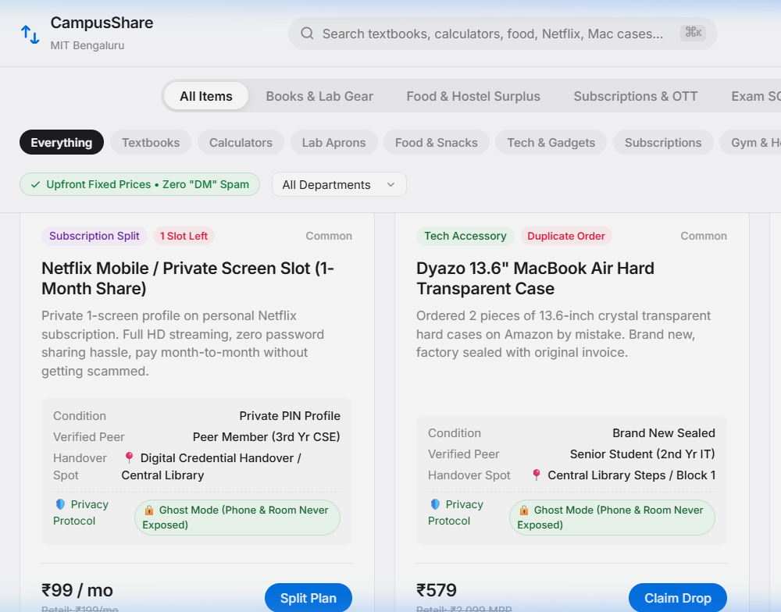
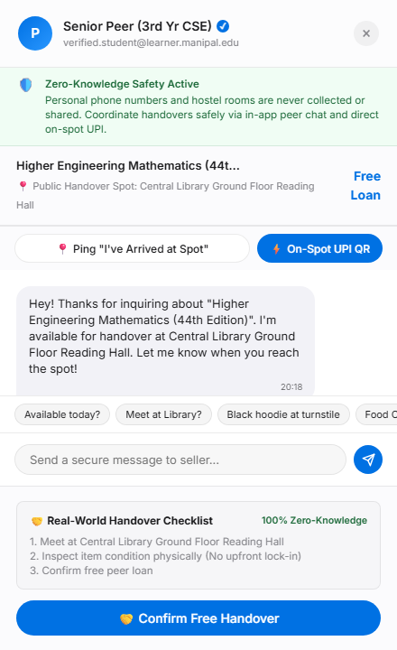
PROTOTYPE DEMONSTRATION
Interactive Web Prototype & Privacy Architecture
Zero-Knowledge Architecture
🛡️ Zero Phone Numbers Anywhere: Personal phone numbers, WhatsApp, and hostel room numbers are NEVER collected, stored, or exposed anywhere on the platform.
🛡️ Stage 1 (Public Feed): Displays ONLY public landmark spots (Library, Food Court) and verified student batch handle.
🛡️ Stage 2 (In-App Peer Chat): Apple slide-over drawer coordinates handover times safely without revealing personal contact details.
🛡️ Stage 3 (Beacon & Direct UPI): Live arrival beacon ping + on-spot direct GPay/PhonePe scan with zero middleman escrow holding student funds.
🛡️ Hostel Safety & Anti-Harassment: Eliminates stalking and number scraping, creating a trusted environment for female students in hostel blocks.

Slide 14
PHASE 4: TESTING & VALIDATION
Testing, Evaluation & Peer Feedback
Peer Walkthrough Methodology
• Method: Structured interactive walkthrough evaluations conducted with hostel wingmates and batchmates across junior and senior engineering cycles.
• Scenario 1 (Seeker Workflow): Finding an exam tool, opening the slide-over peer chat, and triggering the live arrival beacon ping.
• Scenario 2 (Lender Workflow): Listing an unused resource within moments with default Zero-Knowledge Ghost Privacy.
• Evaluation Criteria: Usability clarity, physical safety comfort, and reduction in peer handover friction.
Qualitative Peer Feedback
• Zero-Knowledge Safety: Female students in hostel blocks strongly validated that keeping personal phone numbers and room details completely hidden eliminates harassment risks.
• Direct On-Spot UPI: Peers appreciated inspecting items physically first rather than having money locked into an app escrow.
• Landmark Coordination: Predefined meeting spots (Library, Food Court) removed the awkwardness of coordinating where to meet.
• Transparent Pricing: Freshers praised the upfront price tags, stating they dread asking 'DM for price' on unstructured WhatsApp groups.

Slide 15
CONCLUSION & ROADMAP
Future Scope & Project Conclusion
Future Scope & Roadmap (v2.0)
• WhatsApp Cloud API Webhooks: Automated messaging notifications alerting seniors when a junior requests an item.
• Central Library Smart Lockers: Integration with physical campus lockers for 24/7 contactless handovers and returns.
• Automated Academic Return Prompts: Calendar-synced reminders sent prior to end-semester exams to return borrowed books.
• University Reserve Catalogue Sync: Cross-referencing university library inventory to highlight high-demand out-of-stock reserve books.
Summary of Key Learnings
• Design Thinking forced our team to step back from technical assumptions and understand real human pain points.
• Root causes are rarely technical—the issue wasn't a lack of books, but the friction of discovery, trust, and physical handover.
• By implementing circular resource sharing, CampusShare demonstrates how simple engineering design creates tangible social and economic value for universities.

Slide 16
Thank You!
Questions & Feedback Welcome
CampusShare | Design Thinking (HUM_4342) | MIT Bengaluru

